Slide 1
Simmer
Style Guide

Slide 2
Asset Dimensions and Specifications:
(by pixels)
Characters: 100 x 130
Ingredients: 100 x 100 (prototype?)
Dishes:
Appliances:
Environment Tiles: 100 x 100 tiles
Background/Canvas: 1980 x 1080

Slide 3
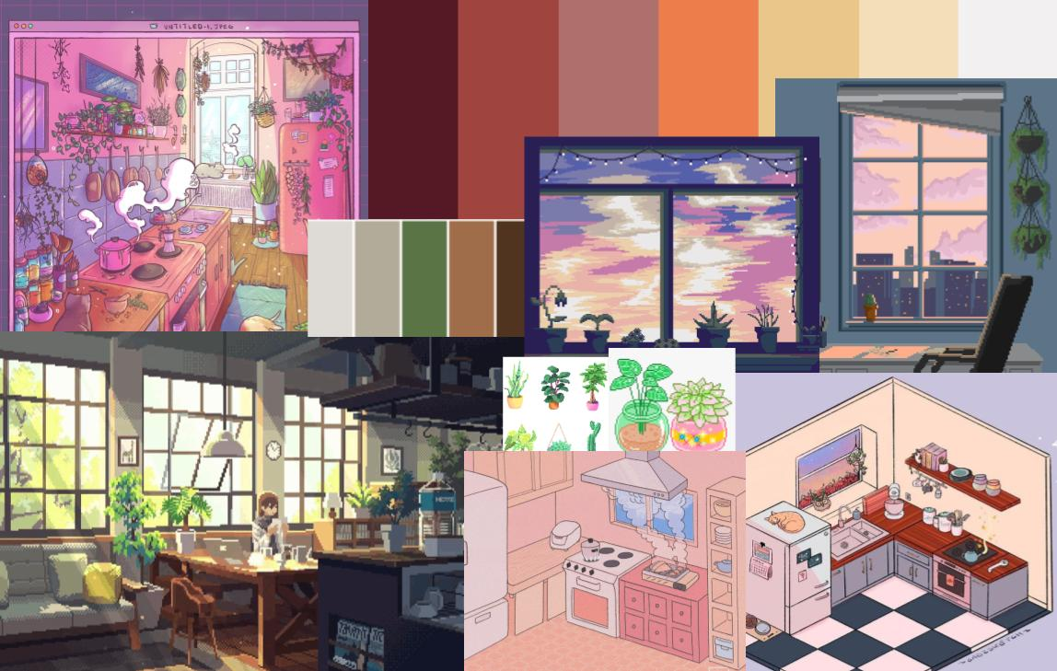
Color Palette & Tone/Mood
homey/warm - woody, looking over the city line
Greenery + plants that connect with nature
Lighting is desaturated sunny and warm - leaning towards yellows and oranges
Shadows are more saturated blues?

Slide 4


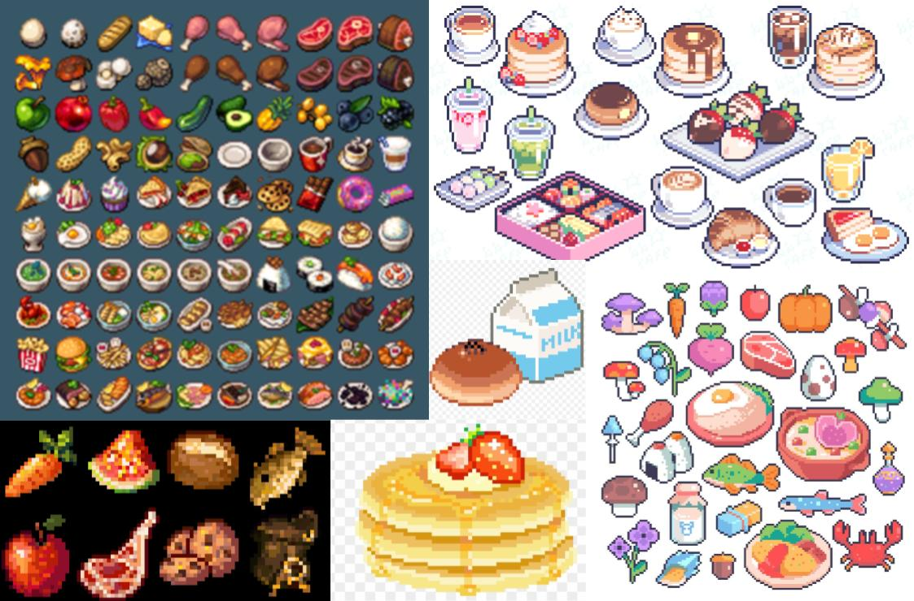
Food
Black outline to help distinguish food from environment
More detailed shading for dishes, minimal shading for ingredients

Slide 5
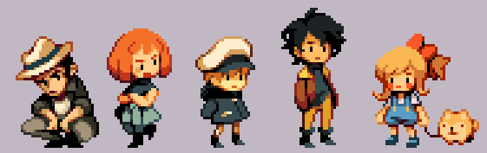

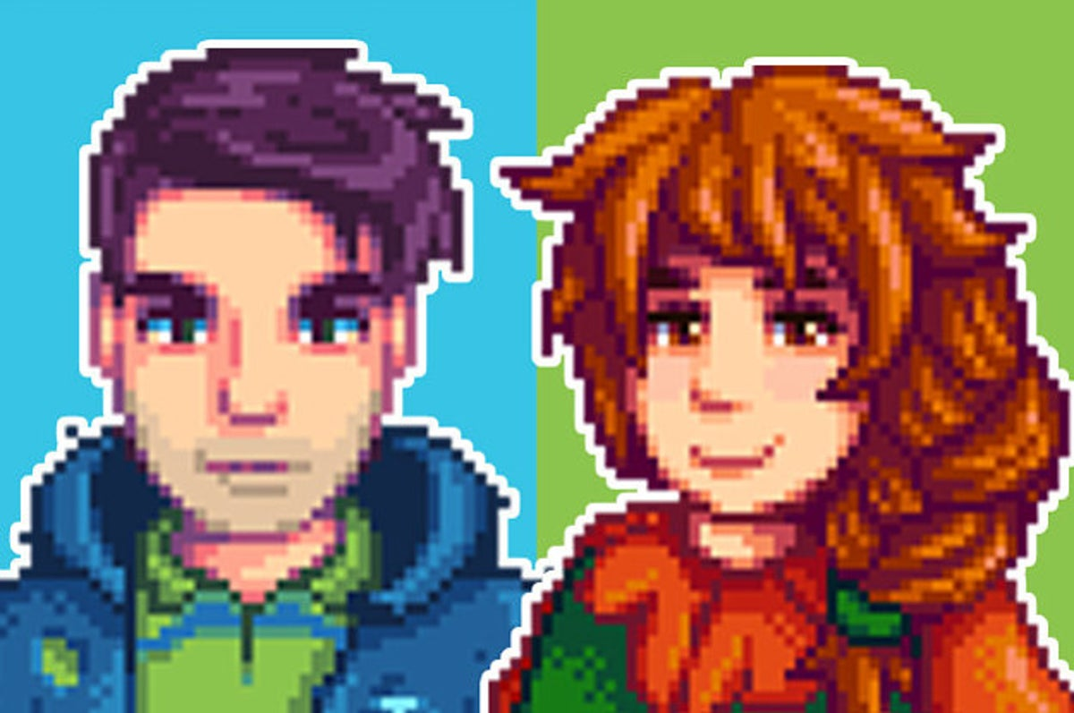
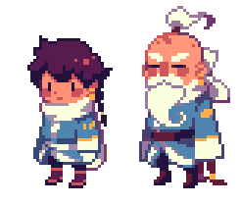
Character/NPC
Whimsical, charming shapely designs and saturated colors
More on cute, cartoony side vs. realism

